Slide 1



UNIT 5; Healthy and green
Helping hands

Slide 2
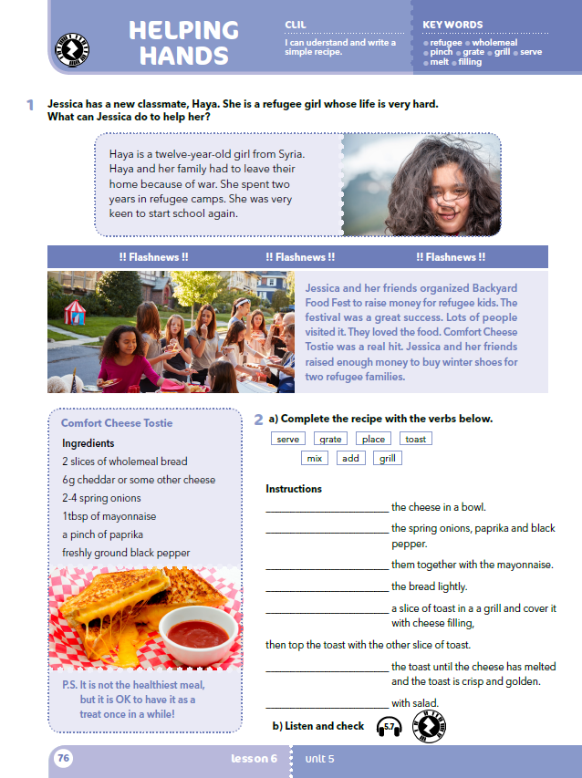
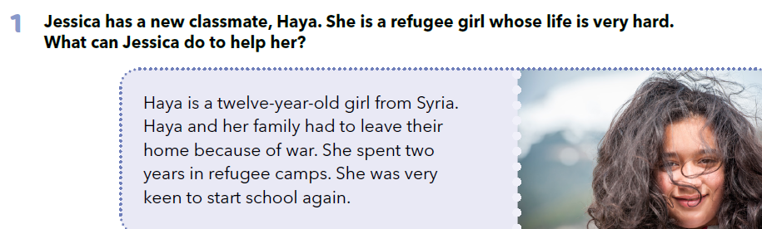
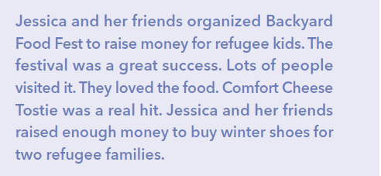
Do you know who refugees are?
Do you know anyone who was a refugee at one point in their life?
When do people become refugees?
How would you feel if you had to leave your home?
What/who would you miss the most?
Would you miss school?
Jessica has a new classmate, Haya.
She is a refugee girl whose life is very hard.
What can Jessica do to help her?

Slide 3

Who is Haya? Where is she from?
Why did her family leave home?
How long was she in refugee camps?
What did she miss while she was in camps?
Did Haya make any friends at school?
What did her friends do for her?
What is Backyard Food Fest?
What did they serve at the festival?
What was its purpose?
How did Hay’s classmates help her family?

Slide 4
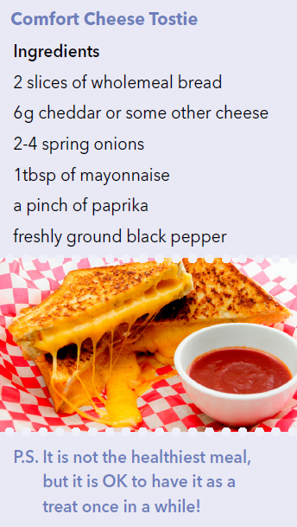

Slide 5
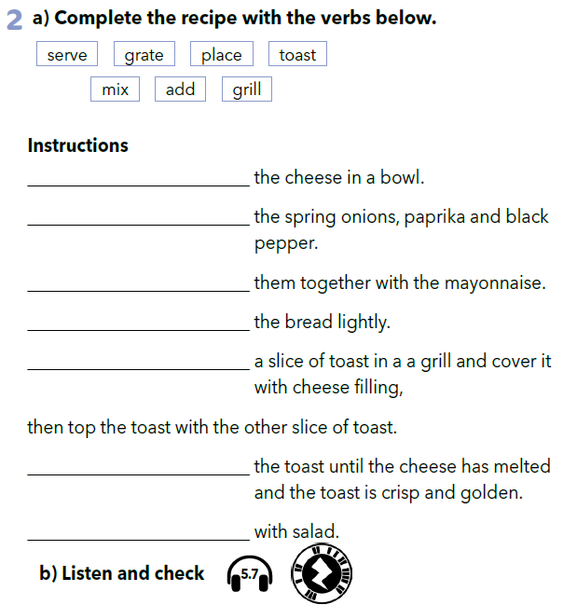

Listen and check! https://www.e-sfera.hr/dodatni-digitalni-sadrzaji/8396cc18-402a-4e42-8cc4-34ab011138ff/assets/audio/29__unit_05_lesson_6_-_comfort_cheese_tostie_1.mp3
grate
add
mix
toast
place
grill
serve

Slide 6
Complete the recipe and copy it.
serve - side - put - oil - eggs - flour
Put 100g ________________, 2 large _______________, 300ml milk, 1 tbsp sunflower or vegetable _______________ and a pinch of salt into a bowl and mix it.
Set a medium frying pan over a medium heat and _____________ a bit of oil into it.
When hot, cook your pancakes for 1 min on each _____________ until golden.
______________ with your favourite filling.

Slide 7
Practise: https://learningapps.org/watch?v=pas8ctdbt20
Pronađi i zapiši recept po kojem sami možete napraviti jednostavno jelo.

